Slide 1
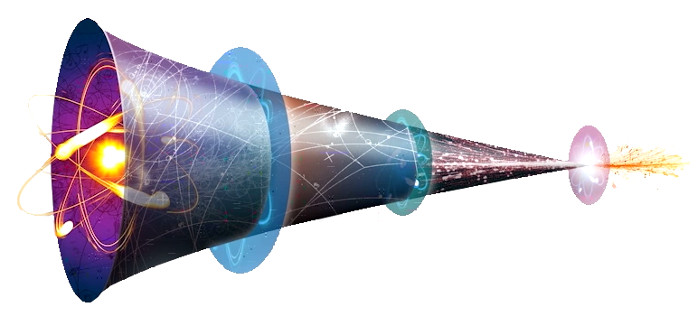
Cro-Fu
FusionFabric CrowdFunding Platform
FusionReactor Project initiated by B. Pulatov & K. El Mourabet
Notes:
Hello Everyone and thanks for having us!
So, What is CroFu?
Cro-Fu is the Hackathon counterpart to the Fusion Reactor CrowdFunding project
The original contributors were Bakthier Pulatov in London and Karim El Mourabet in Dubai.
This should serve as evidence in the CrowdFunding case that we,Misys should build this solution … now.

Slide 2
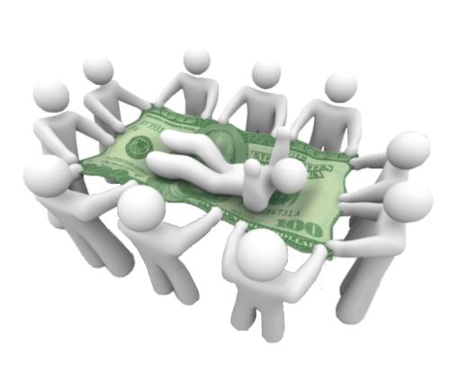
What is CrowdFunding?
CFPs are Online Marketplaces
Disruptive to Lending Business
$34bn in yearly transactions
Expected $1tn by 2020
$1,000,000,000,000
Notes:
So what is Crowdfunding?
<click>
A Crowd Funding Platform is a web based market place were projects meet funders.
<click>
This is an alternative to traditional lending, because funds come from individuals.
<click>
As we speak, there are over 1300 platforms that process 34 billion dollars per year.
<click>
The target market size for 2020 is $1tn
<click>
That is one million, million dollars.

Slide 3


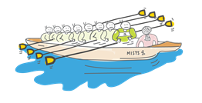

Why Misys and Fusion Crowdfunding?
Technology
Culture
Legitimacy
Notes:
Mysis is the perfect provider for this solution
<click> Our technology is especially fit. Fusion Fabric brings Performance, Availability and is SaaS ready.
<click> We are completely legitimate with our existing Client Base of retail and commercial banks, and our existing offering with FusionBanking Lending
<click> We have the right culture:
<click> We want to help our customers take their first step into this new generation of financial products.
<click> Building a new Market place is a great challenge.
<click> This is a juicy greenfield market for us.

Slide 4
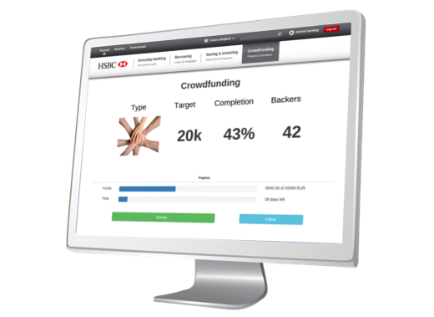




Hackathon Challenges
Integration with Bank Systems
Website & Rest Services,
Data Publication ⇨ Fusion Business Insight
Scalability
Global Retail Base ⇨ 24/7
Multi node FF
Artificial Intelligence
Optimized Projects Recommendation
Notes:
We would like to showcase 3 aspects of the solution in the context of this Hackathon
<click> The system needs to integrate to existing bank websites as well as data consumers, such as FBI.
<click> It needs to be able to cope with large volumes.
<click> It needs to be smart enough to maximize platform revenue by optimizing projects recommendations

Slide 5
Demo

Slide 6
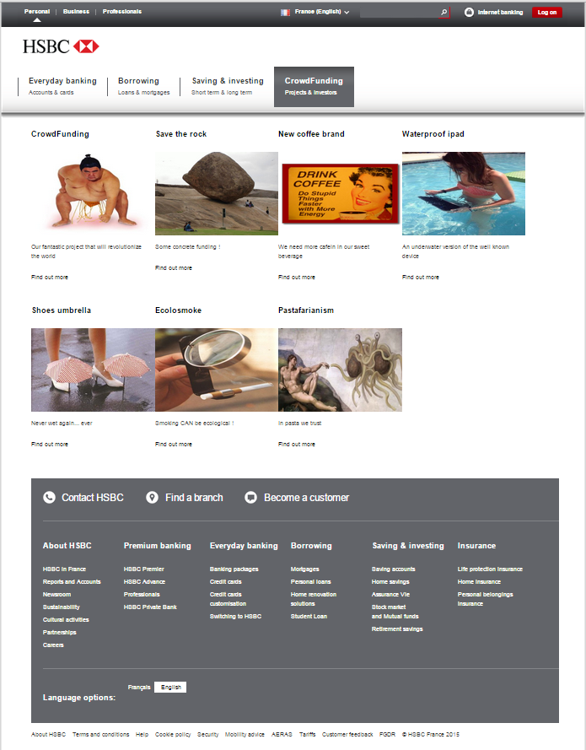
Websites Integration
Notes:
What we see here is an existing HSBC website that leverages FusionFabric services to enable CrowdFunding offering.
As a user I can log into my bank website and browse existing projects
<drill crowd funding> In this list, I can pick whatever project is relevant to me,
<drill in project> See what the current state is, and either contribute or Follow this project for later
Let s make a donation
<click donate> From here
<open sources list> I can choose where the money comes from
<type in amount> Enter the amount I wish to donate
<click donate and close thank you> I can then go back to this project
<reopen project status> And see that progress has been recorded.

Slide 7
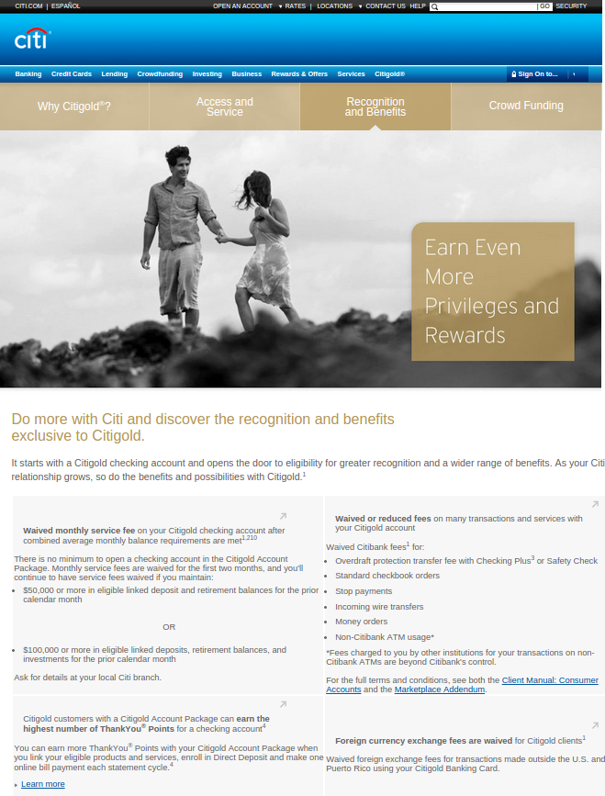
Custom Recommendation
Notes:
<tab 2>
In this tab, I have a Citibank website powered by the same service.
<click Crowdfunding>
Projects recommendation are catered to individual user profile using Apache Mahout technology.
Please ask us questions about this.
Besides user facing services, the platform is also able to produce metrics
<tab 3, Show JSON> that could be consumed by processors such as Fusion Business Insight.

Slide 8
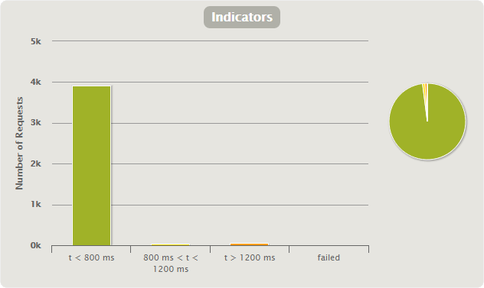
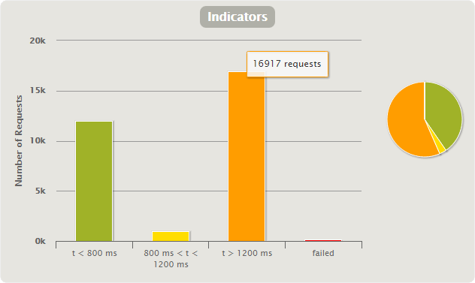
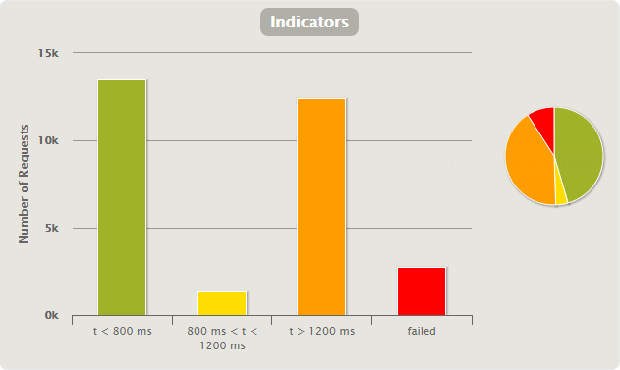
Scalability
1k users / 1 node : 98-1-1-0
10k users / 1 node : 45-4-41-9
10k users / 2 nodes : 40-4-56-0
Notes:
In order to cope with volumes, we had to implement a multi node FusionFabric architecture
<click>Processing request from 1k users went smooth
<click> Ramping up to 10k users showed we were losing about 10% of inbound traffic
<click> By adding a second node to our cluster, we immediately remediated the loss

Slide 9
Conclusion

Slide 10
Takeaways
Market is Ripe
Misys is the Perfect Provider
Notes:
<click>Market is ripe for this solution
<click> Misys is the perfect Provider

Slide 11
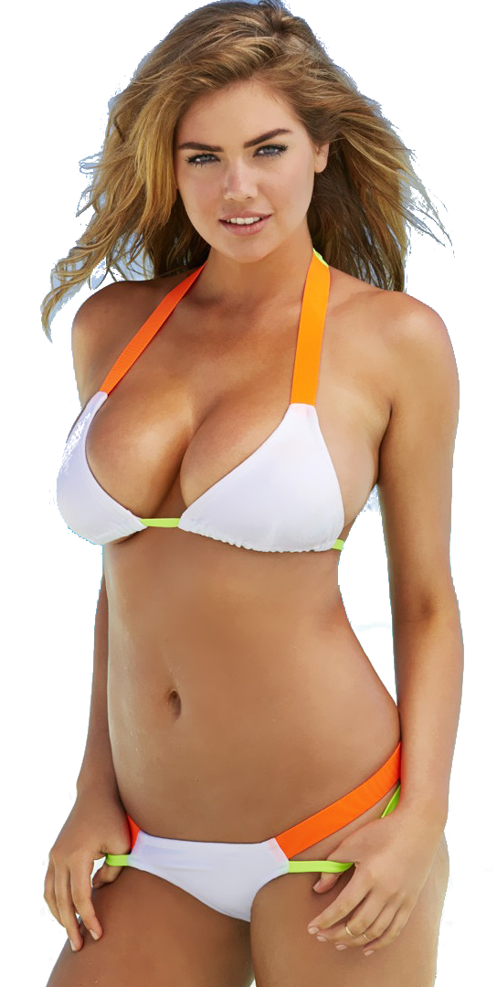
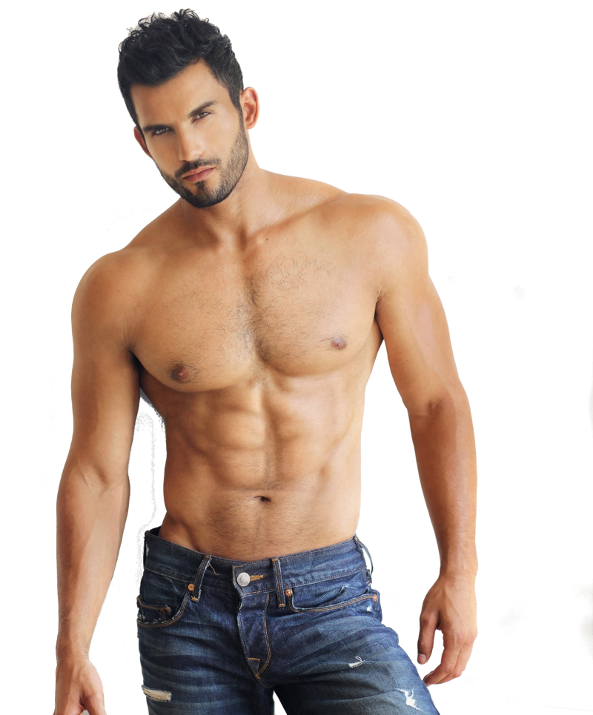
Marketing is Essential
Guys,
Cro-Fu is the best project
Ladies, Vote for Cro-Fu
Notes:
Bruno Hourdel will probably tell you that Marketing is Critical to our Success. We agree
<click>

Slide 12
Frederic Andre, Marie-Lise Hamel, Jean-Cedric Jollant, Laurent Lhermine Consultants K. El Mourabet, R. Gilles, Y. Maman, H. Pereira, B. Pulatov

Slide 13
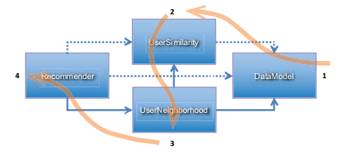
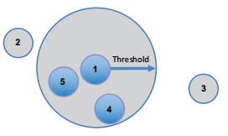
Machine Learning
Recommendation system
Known users (Netflix Rating like system)
Based on contributions
Similarity metrics :
Pearson correlation
Euclidian distance …
Notes:
<click>Pearson correlation : number between -1 and 1 that measures tendency of 2 series of numbers, paired, to move together, but limitation

Slide 14
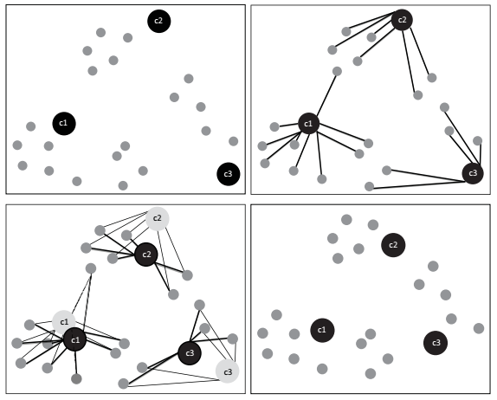
Machine Learning
User clustering :
Based on expenses data
K-Mean clustering
Methods based on n dimension vectors
Euclidian distance, squared
Manhattan distance
Cosine distance
Notes:
<click>Group people by similarity based on expenses, K-Mean method uses several iterations to found the Centroid

Slide 15
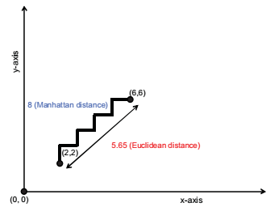
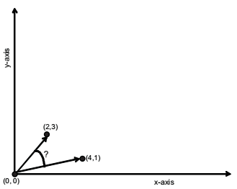
Machine Learning
Euclidian / Manhattan
Cosine

